Slide 1
Indexing Strategies
Md. Khairul Alam MCTS, MCPD,CSM
Software Engineer, AML
DataSoft Systems Bangladesh Limited

Slide 2
Why & What ??
A database index is a data structure that improves the speed of data retrieval operations on a database table at the cost of additional writes and storage space to maintain the index data structure. Indexes are used to quickly locate data without having to search every row in a database table every time a database table is accessed. Indexes can be created using one or more columns of a database table, providing the basis for both rapid random lookups and efficient access of ordered records

Slide 3
The Art of Indexing
Indexing and performance tuning are a mixture of art and science.
The science portion includes knowing the details of how indexing works under the covers and when it makes sense to define indexes on the appropriate columns on a table.
The art portion includes knowing when to stray away from what conventional wisdom tells you to do and designing a proper indexing strategy for what works best for your environment.

Slide 4
Indexing Basics
The two main types of indexes in SQL Server are clustered and nonclustered indexes.
Each index type is implemented via a balanced-tree (B-tree) data structure. A B-tree is a structure that stores data in a sorted order and enables fast access to the data it holds.

Slide 5
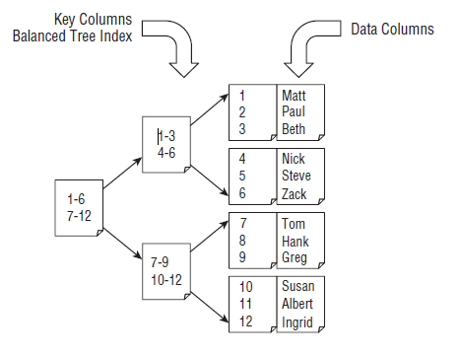
The B-Tree Index

Slide 6
Clustered Indexes
When a clustered index is created on a table, the index itself becomes the table.
The clustered index doesn’t become a separate structure for the underlying table data like a nonclustered index does.
The clustered index is the table.
A great example to illustrate a clustered index is a telephone book. A telephone book is always in sorted order, based on the last name of the individual followed by the first name . The sorted order makes it easy to find the phone number of the person you’re looking for.

Slide 7
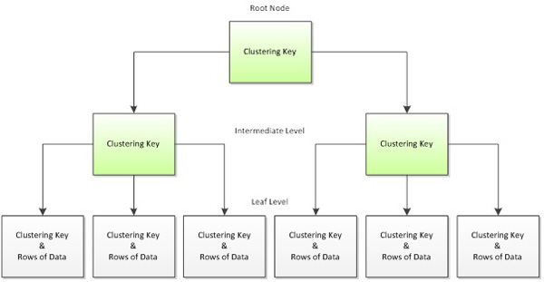
Clustered Indexes

Slide 8
Clustered Indexes Creation
IF NOT EXISTS (SELECT 1 FROM sys.indexes I WHERE I.Name = 'CIX_CustomerInformations_Id' AND I.object_id = OBJECT_ID('dbo.CustomerInformations'))
CREATE CLUSTERED INDEX CIX_CustomerInformations_Id On CustomerInformations(Id Asc)
GO
DROP INDEX CIX_CustomerInformations_Id ON CustomerInformations

Slide 9
Nonclustered Indexes
SQL Server nonclustered indexes are also implemented as a B-tree data structure.
The leaf level of the nonclustered index contains the index keys along with a pointer to the base table. If the nonclustered index is not unique, all levels of the index contain a pointer to the base table.
If the base table is a clustered index, the clustered keys are stored in the nonclustered index.

Slide 10
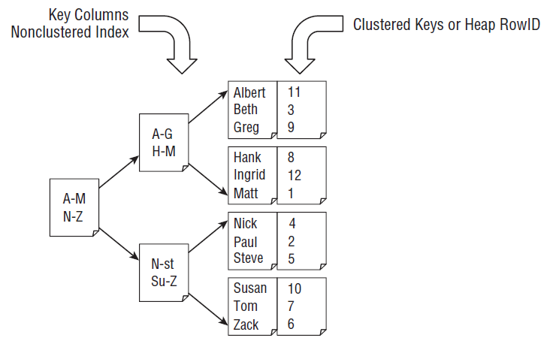
Nonclustered Indexes

Slide 11
Nonclustered Indexes
IF NOT EXISTS (SELECT 1 FROM sys.indexes I WHERE I.Name = 'NCIX_CustomerInformations_FirstName' AND I.object_id = OBJECT_ID('dbo.CustomerInformations'))
CREATE NONCLUSTERED INDEX NCIX_CustomerInformations_FirstName On CustomerInformations(FirstName Asc)
GO
DROP INDEX NCIX_AccountInformations_AccountId ON AccountInformations

Slide 12
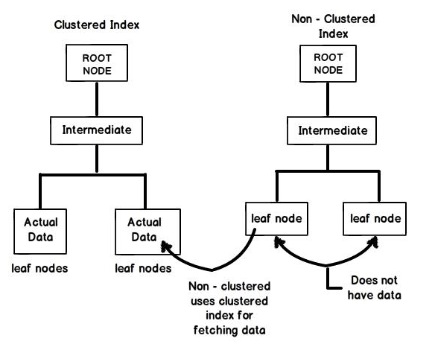
Clustered vs Non-Clustered

Slide 13
Composite Indexes
A composite index is a clustered or nonclustered index that is defi ned on multiple columns.
Its basic syntax is as follows.
CREATE INDEX index_name
on table_name (column1, column2);

Slide 14
Unique Indexes and Constraints
A Primary key and unique constraints are the method you use to uniquely identify a row.
Indexes and primary keys are intertwined and a primary key must always be indexed.
By default, creating a primary key automatically creates a unique clustered index, but it can optionally create a unique nonclustered index instead.
A unique constraint and a unique index are the same thing — creating either one builds a unique constraint/index.

Slide 15
The Page Split Problem
If the index page to which a value needs to be added is full, SQL Server must split the page into two less full pages so that it can insert the value in the correct position.
Page splits may cause several performance-related problems:
The page split operation is expensive because it involves several steps and moving data.
If after the page split there still isn’t enough room, the page will be split again. This can occur again and again based on certain circumstances.
The data structure is left fragmented and can no longer be read in a single contiguous pass.
Page splits are also logged operations and can have a significant impact on the transaction log.

Slide 16
Query Operators
■ Table Scan: Reads the entire heap and, most likely, passes all the data to a secondary filter operation.
■ Index Scan: Reads the entire leaf level (every row) of the clustered index or nonclustered index. The index scan operation might filter the rows and return only those rows that meet the criteria, or it might pass all the rows to another filter operation depending on the complexity of the criteria. The data may or may not be ordered.
■ Index Seek: Locates specific row(s) of data using the B-tree and returns only the selected rows in an ordered list

Slide 17
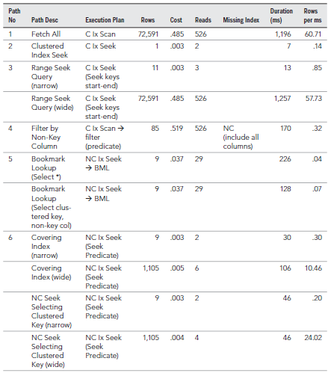
Query Path Performance

Slide 18
The Column store Index
New to SQL Server 2012 is the Columnstore index, which is structured and behaves differently than traditional B-tree indexes. With B-tree indexes, column values are stored in rows in a page.
However, with Columnstore indexes, the column values are stored together in segments, which allows for incredible data compression while dramatically increasing speed of processing for scanning huge amounts of data.

Slide 19
Indexed Views
When a denormalized and pre-aggregated data solution needs to be in real time, an excellent alternative to querying the base tables includes using indexed views. Indexed views are “materialized” in that when the base table is updated the index for the view is also updated. This stores pre-aggregated or deformalized data without using special programming methods to do so.

Slide 20


